Slide 1
PHY105N: M8-11AM, 8.208

Slide 2
Questions?

Slide 3
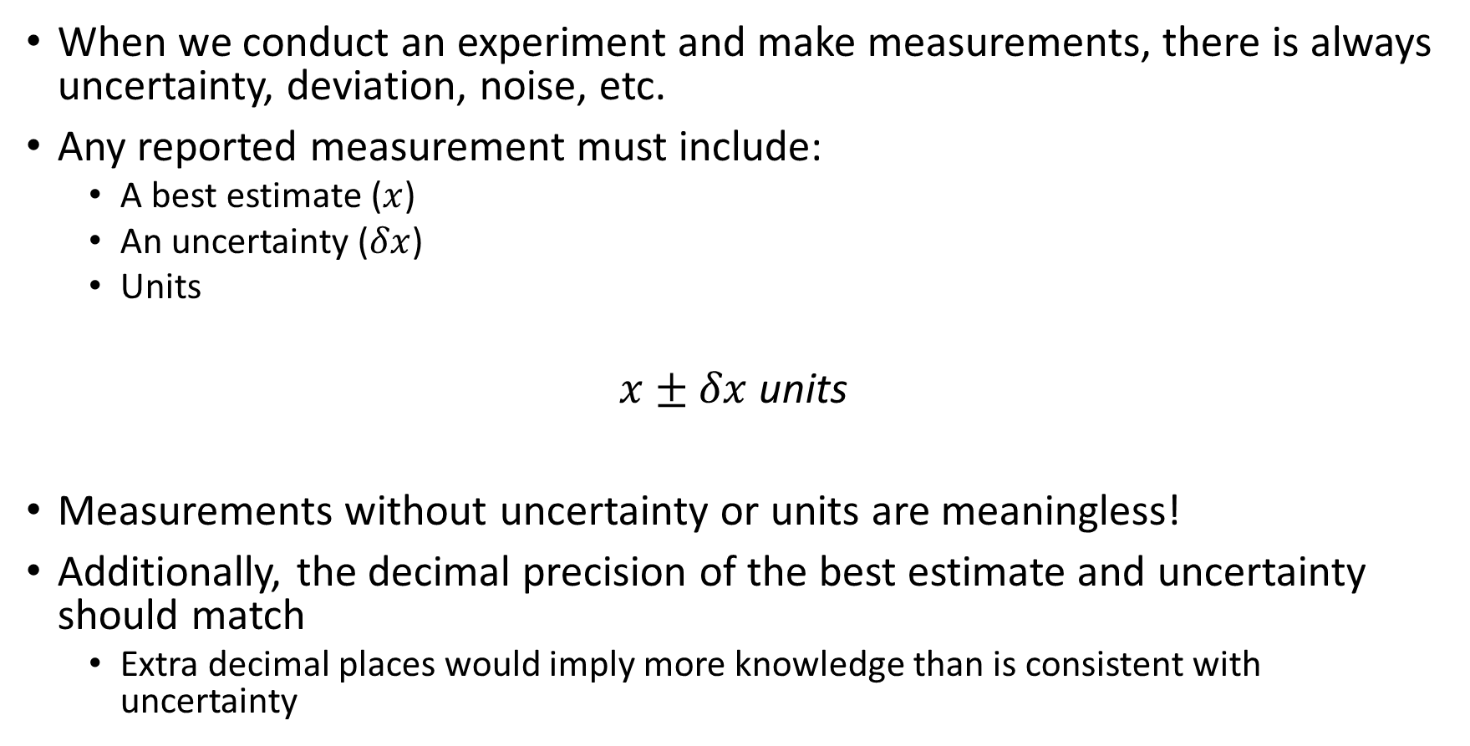
Experimental Results are Not Just Numbers!
When we conduct an experiment and make measurements, there is always uncertainty, deviation, noise, etc.
Any reported measurement must include:
A best estimate ($x$)
An uncertainty ($δx$)
Units
$x±δx$ units
Measurements without uncertainty or units are meaningless!
Additionally, the decimal precision of the best estimate and uncertainty should match
Extra decimal places would imply more knowledge than is consistent with uncertainty

Slide 4
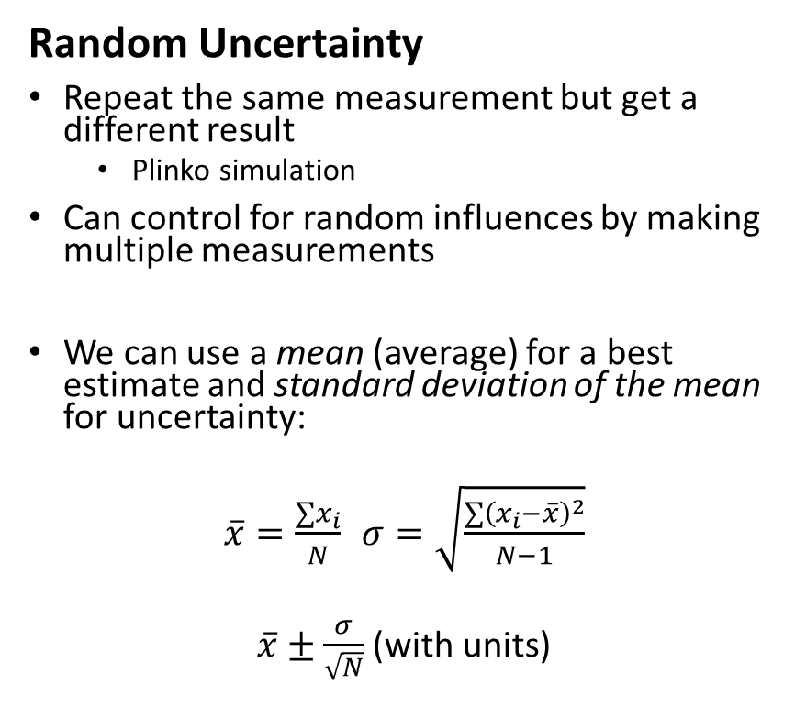
Uncertainties
Systematic Uncertainty
“Measuring device uncertainty”
Analog devices have uncertainty ½ the increment of the marking
Digital devices have uncertainty of the smallest digit since we cannot see indication between the final digit
Devices have systematic uncertainty due to imperfections, but we assume they are smaller than the reported precision
Random Uncertainty
Repeat the same measurement but get a different result
Plinko simulation
Can control for random influences by making multiple measurements
We can use a mean (average) for a best estimate and standard deviation of the mean for uncertainty:
$\overline{x}=\frac{∑x_{i}}{N}$ $σ=\sqrt{\frac{∑{\left(x_{i}−\overline{x}\right)}^{2}}{N−1}}$
$\overline{x}±\frac{σ}{\sqrt{N}}$ (with units)
If we have multiple sources of uncertainty (for example both systematic and random uncertainty) then use the larger of the two*
*for now

Slide 5
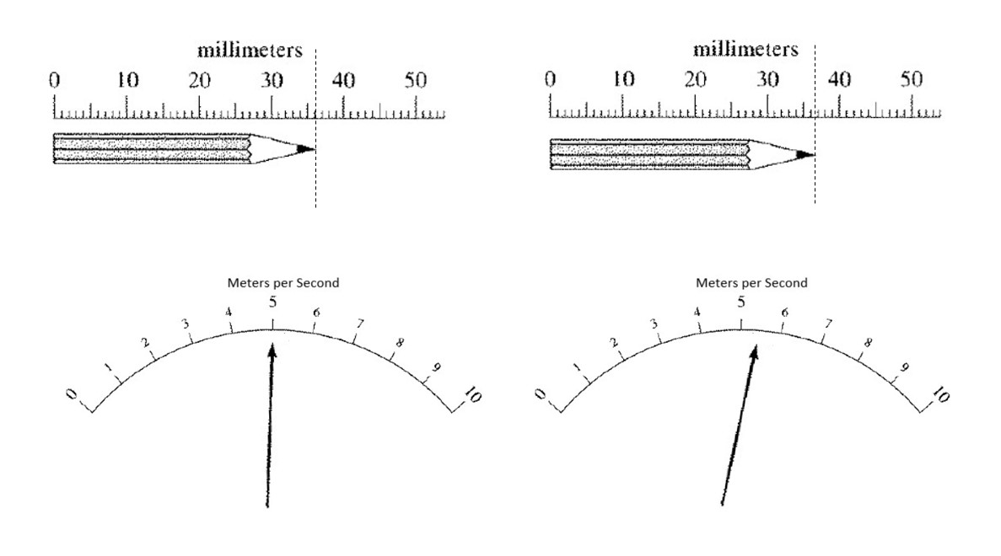
Prelab 0 Invention Activity

Slide 6
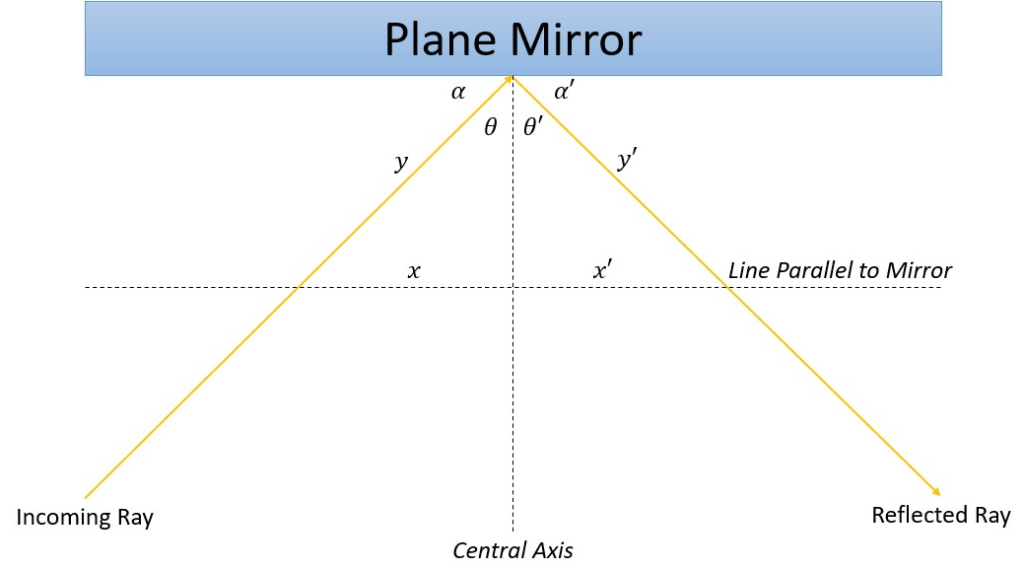
Law of Reflection
Reflection off an interface is perfectly symmetric

Slide 7
Lab 0
Overview
Labs will have 2 parts
Part 1 to test out the model
Part 2 to revise, improve, or expand investigation
There is a flowchart on Canvas if confused
Make sure to take notes along the way
Check-ins with TA, other groups
Lab 0 walks through the “Lab Notes” that you will submit
Rubric on Canvas to see how you will be graded
Turn in next week when you come into class
Should be about 1 page per part
+ In your conclusion, make sure to explain why you chose the precision of your results
- Points not given for percent difference
Safety Concerns!

